Slide 1


“Discovering Credible Twitter Users in Stock Market Domain”
Presented By
BHAVYA BABUTA (1DS14IS020)
K. ABHIJIT (1DS14IS041)
KUSUMA.N (1DS14IS048)
LOVEY (1DS14IS049)
Under The Guidance Of
VANI K A
Asst. Professor
Department of ISE, DSCE
1
Notes:
1

Slide 2
CONTENTS
1.Introduction
2.Motivation to choose the Project
3.Problem Statement
4.Scope and objective of the project
5.System requirements and specifications
6.System design and development
7.Implementation
8.Conclusion
9.Future Enhancements
10. References
Department of ISE, DSCE
2
Notes:
2

Slide 3
INTRODUCTION
On a global level, social networks has changed the face of traditional information ﬂow, people can share their own opinion about almost everything on the Web. Twitter, is one of the most popular microblogs in the world which covers a wide range of active and passive users from ordinary people to experts.
This provides a valuable source of information to learn about future events such as stock market analysis. But one question has to be answered yet:
How can we ﬁnd these credible users to follow them in a prediction task?
Department of ISE, DSCE
3
Notes:
3

Slide 4
MOTIVATION TO CHOOSE THE PROJECT
Even with the advancement in technology there is no definite prediction system for the stock market.
The main aim is to solve the issue with socio-technical investigation technique that is twitter and thus identify most credible Twitter users, who are experts in the stock market.
(It is hypothesized that expert users follow and might be potentially pursued by relevant and other domain experts and in this case, other stock market experts.)
Department of ISE, DSCE
4

Slide 5
PROBLEM STATEMENT
To present a novel approach to measure the credibility of Twitter users in a domain of interest, namely the stock market.
Department of ISE, DSCE
5

Slide 6
SCOPE AND OBJECTIVES OF THIS PROJECT
To study the correlation between the stock market and social media like twitter.
To measure the credibility of twitter users in the domain of stock market based on four features:- number of followers, number of stock market related followers extracted by $Cashtag-based approach, ratio of stock market related followers to the total number of followers, and number of seed user tweets.
Department of ISE, DSCE
6

Slide 7

SYSTEM REQUIREMENT SPECIFICATIONS
HARDWARE REQUIREMENTS
Processor: Intel CoreTM i5
Hard Disk: 500GB
RAM: 4GB
SOFTWARE REQUIREMENTS
OS version: Windows 8(64-bit)
Coding language: Python
Tkinter, a python library for Programming the UI.
Tweepy — Twitter API wrapper for python.
Numpy--- Data structures for matrix manipulation
GausssiaNB Naïve Bayes Classifier from SCI Learn for machine learning
RE—for Regex i.e Cash tag filtering.
Department of ISE, DSCE
7
Notes:
7

Slide 8
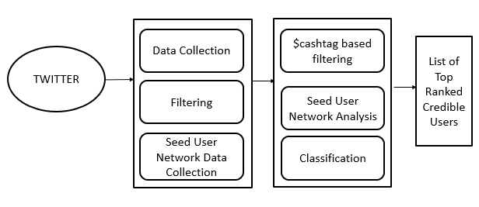
SYSTEM DESIGN AND DEVELOPMENT
Fig 1: Architecture of Discovering Credible Twitter users in Stock Market Domain.
Department of ISE, DSCE
8
Notes:
8

Slide 9
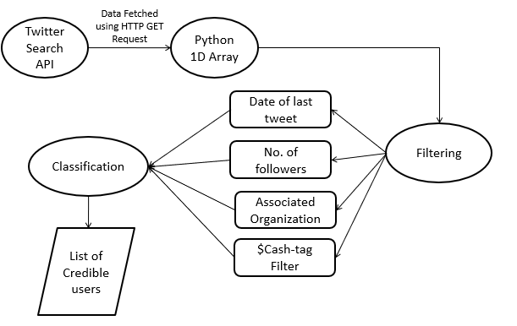
DATA FLOW DIAGRAM
Fig 2: Data Flow Diagram
Department of ISE, DSCE
9
Notes:
9

Slide 10
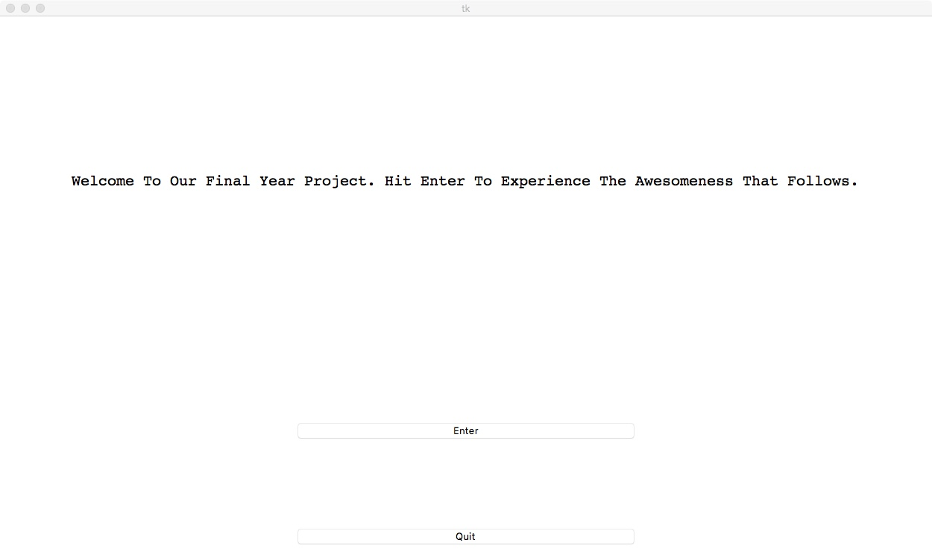
IMPLEMENTATION
Welcome Page
Department of ISE, DSCE
10
Notes:
10

Slide 11
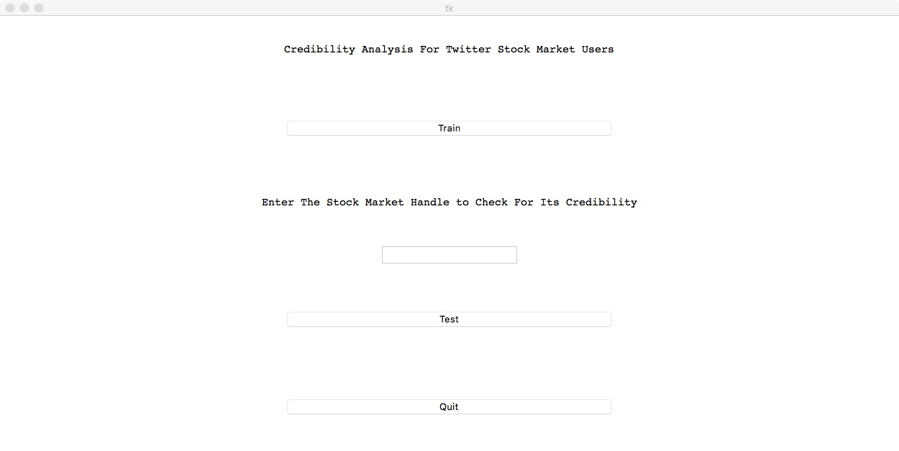
IMPLEMENTATION
First Page
Department of ISE, DSCE
11
Notes:
11

Slide 12
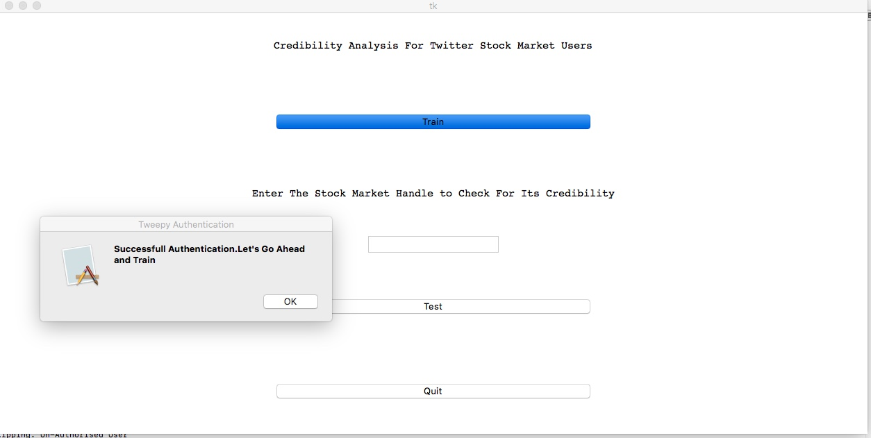
IMPLEMENTATION
On Successful Authentication
Department of ISE, DSCE
12
Notes:
12

Slide 13
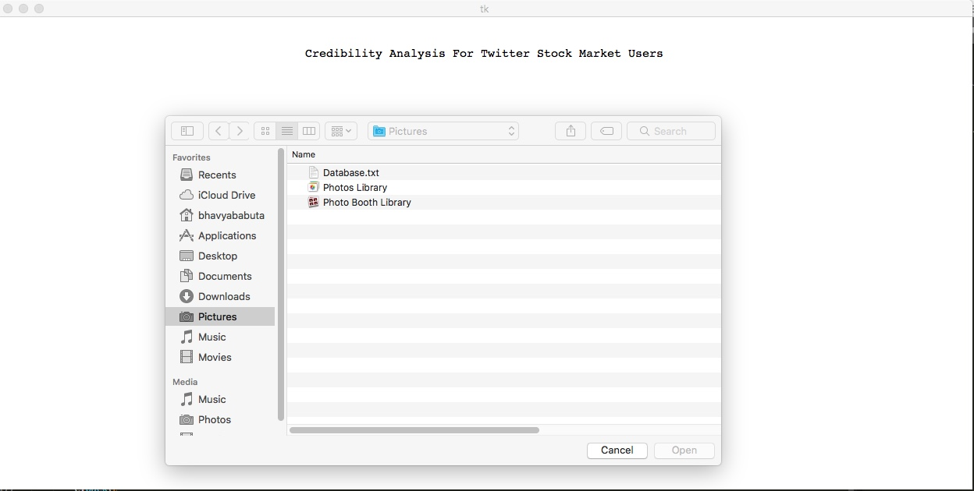
IMPLEMENTATION
Selecting Dataset
Department of ISE, DSCE
13
Notes:
13

Slide 14
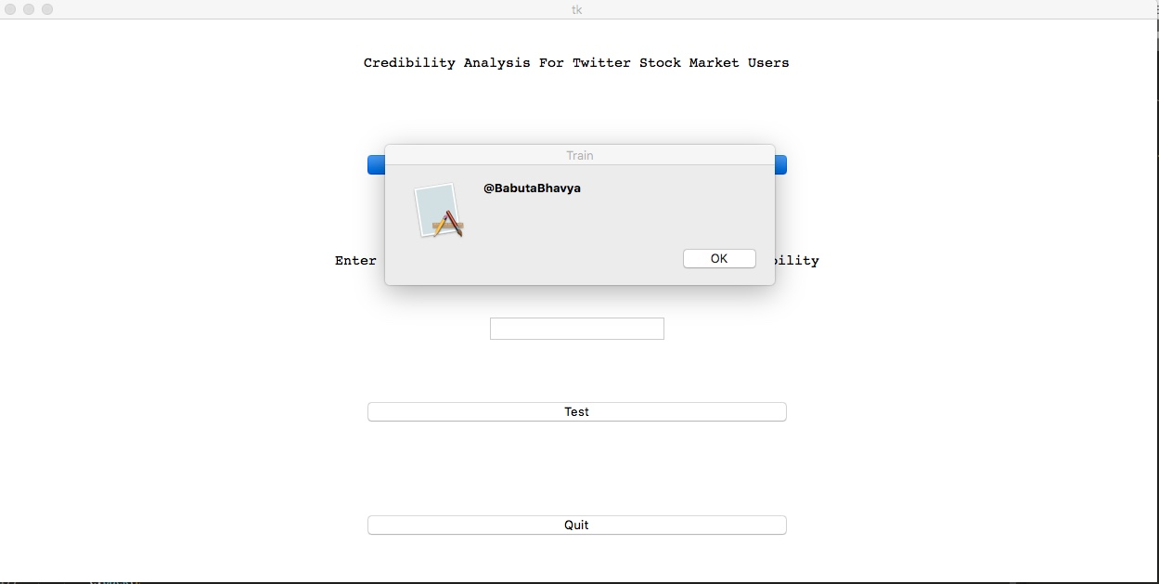
IMPLEMENTATION
Training the dataset
Department of ISE, DSCE
14
Notes:
14

Slide 15
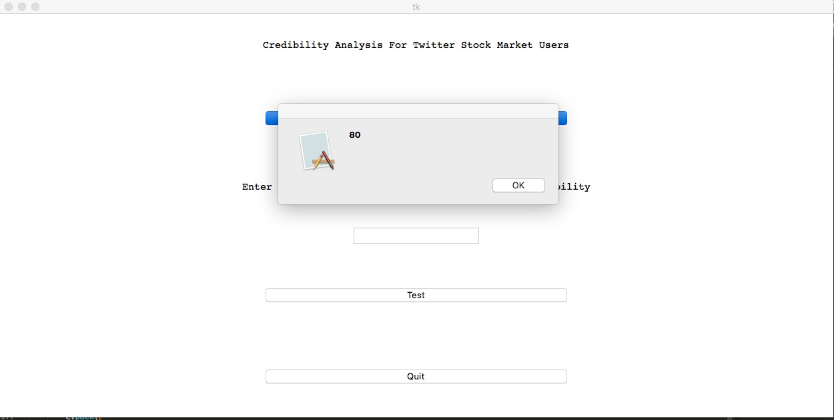
IMPLEMENTATION
Number of followers for the user is displayed.
Department of ISE, DSCE
15
Notes:
15

Slide 16
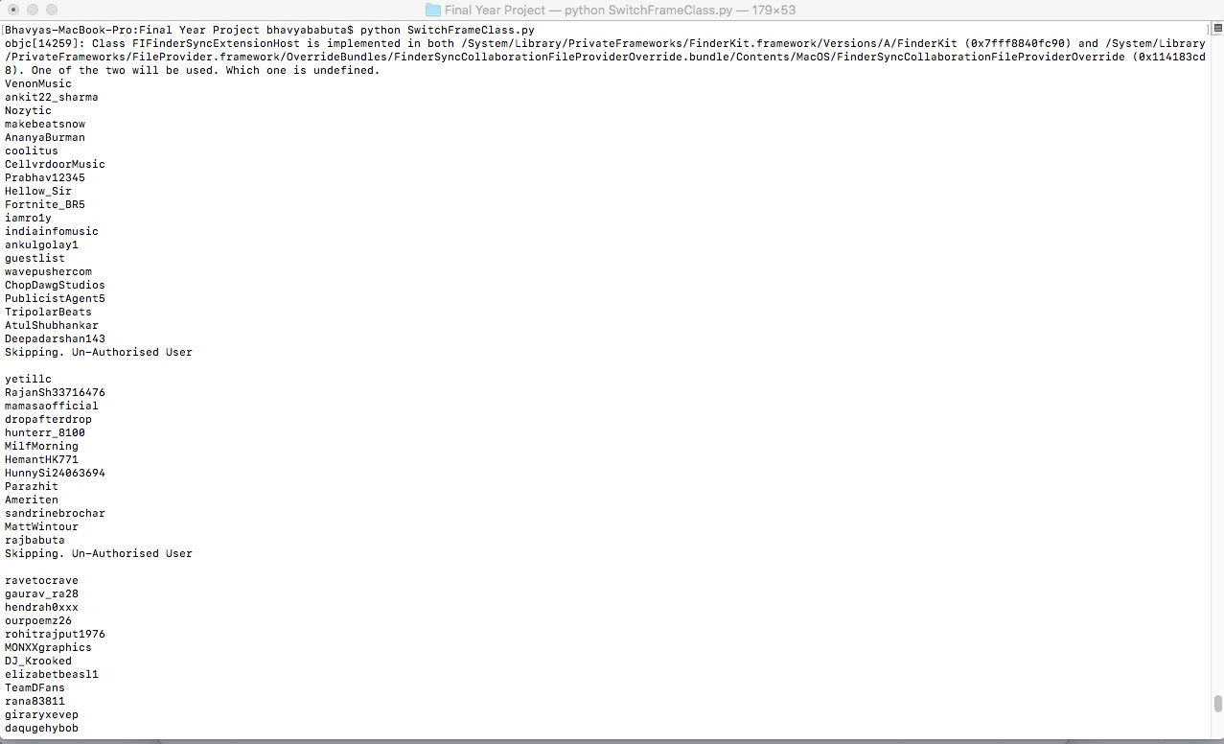
IMPLEMENTATION
Backend Data Extraction.
Department of ISE, DSCE
16
Notes:
16

Slide 17
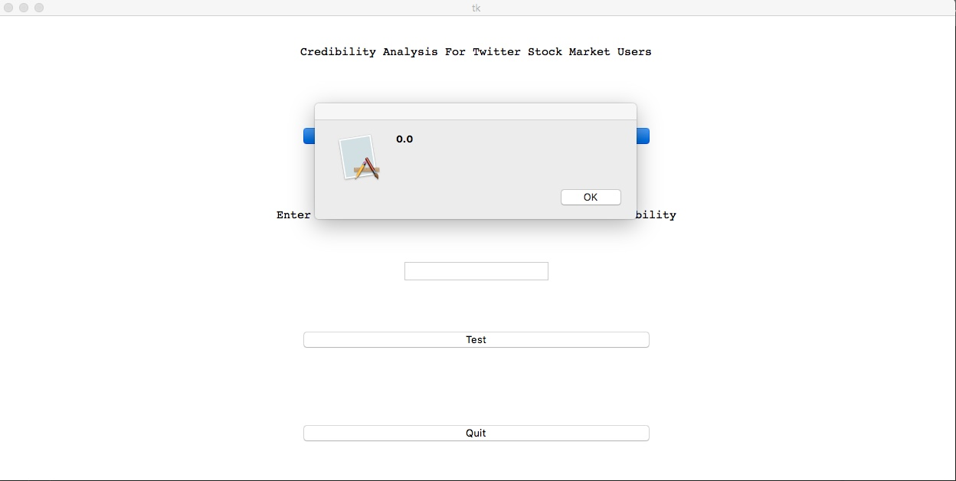
IMPLEMENTATION
Displaying Ratio
Department of ISE, DSCE
17
Notes:
17

Slide 18
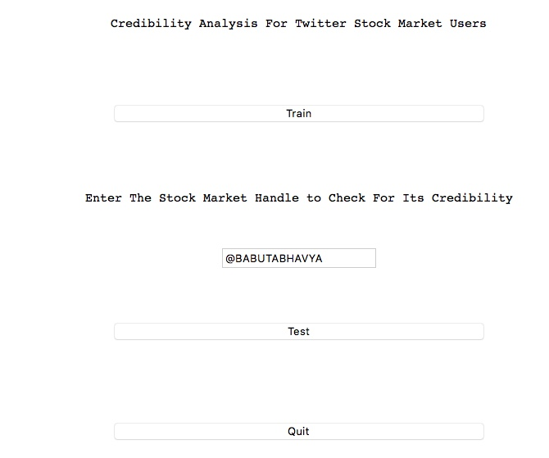
IMPLEMENTATION
User Input
Department of ISE, DSCE
18
Notes:
18

Slide 19
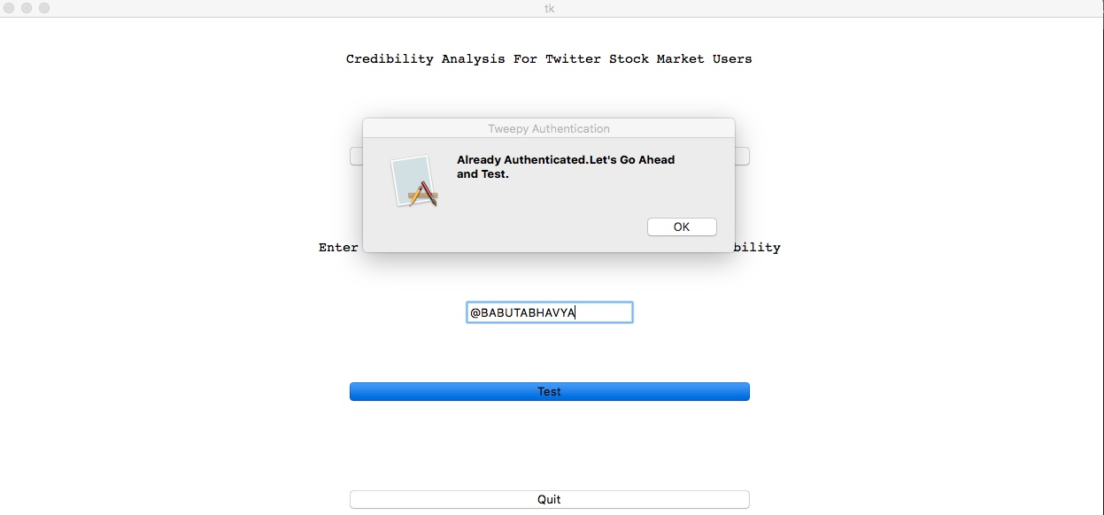
IMPLEMENTATION
Testing the user input
Department of ISE, DSCE
19
Notes:
19

Slide 20
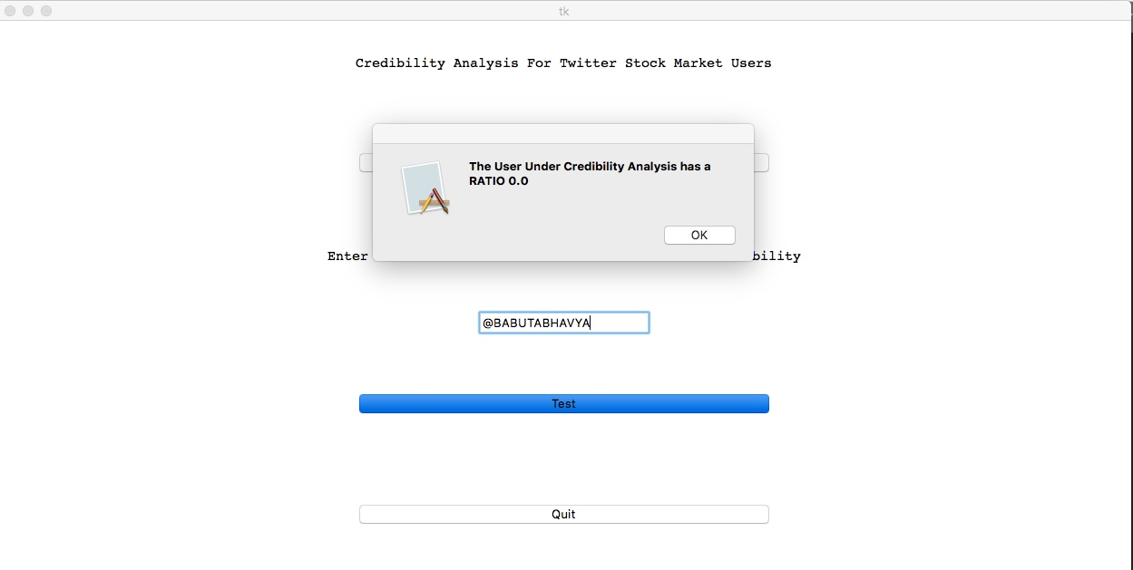
IMPLEMENTATION
Displaying credibility analysis.
Department of ISE, DSCE
20
Notes:
20

Slide 21
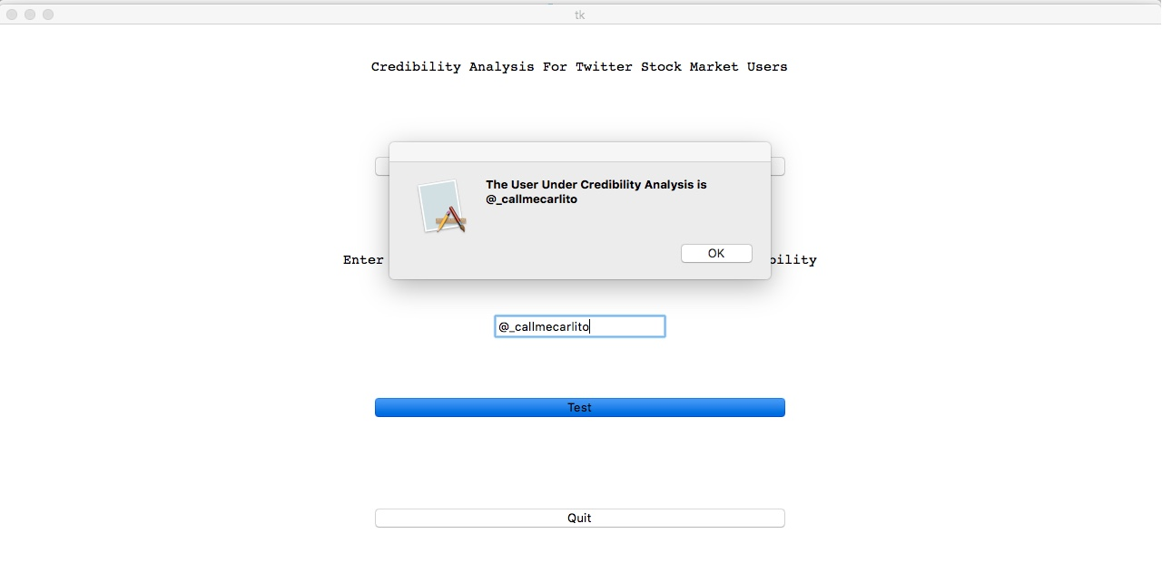
IMPLEMENTATION
Testing for another twitter user.
Department of ISE, DSCE
21
Notes:
21

Slide 22
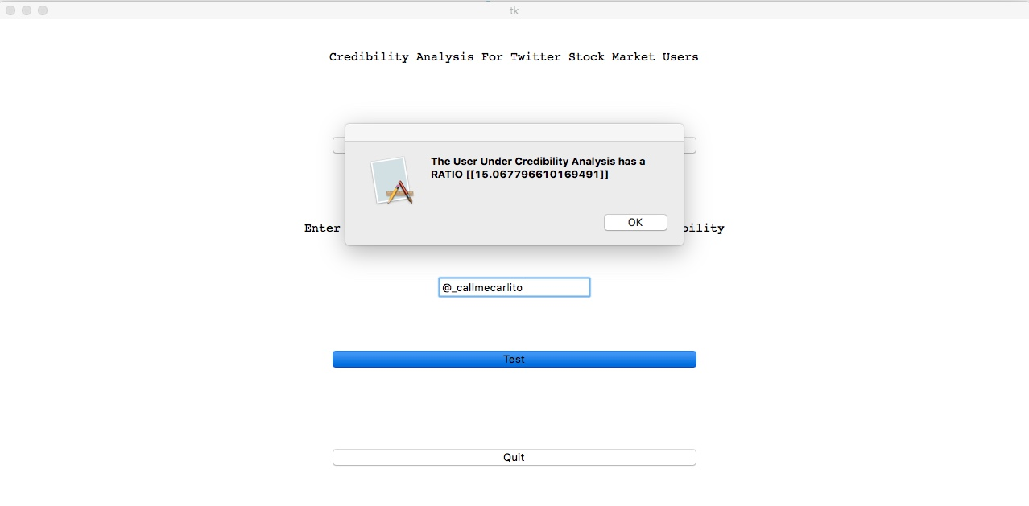
IMPLEMENTATION
Displaying the ratio for the user.
Department of ISE, DSCE
22
Notes:
22

Slide 23
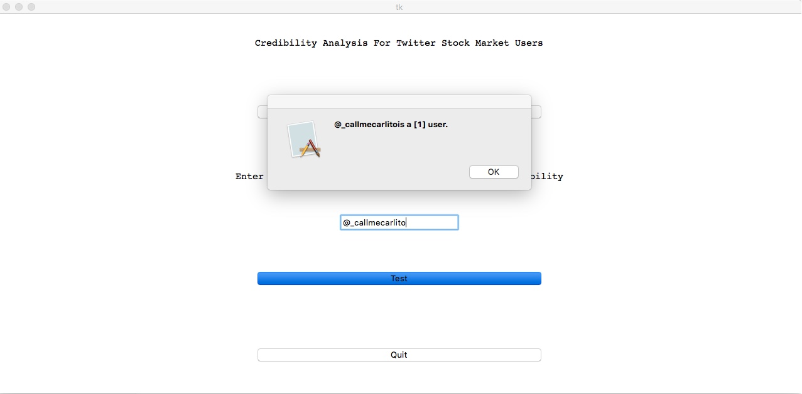
IMPLEMENTATION
Displaying result of credibility analysis for the user, where 1 indicates credible and 0 indicates a non-credible user.
Department of ISE, DSCE
23
Notes:
23

Slide 24
CONCLUSION
This project presents a novel approach to discovering credible stock market expert users in Twitter, based on four features:-
number of followers;
number of stock market related followers, extracted by a $Cashtag-based approach;
ratio of stock market-related followers to the total number of followers;
and the number of seed user tweets.
A relationship was found between user predictions and their social networks in Twitter.
From the presented results, a correlation between user credibility and follower networks was observed, conﬁrming the proposed hypothesis of a direct relationship between user social networks and their credibility.
The proposed approach identiﬁes that, in order to ﬁnd the most credible expert users in the stock market ﬁeld as well as other domains of interest, analyzing proﬁles and social networks, does not need to address natural language processing challenges. This method is more reliable and less complex than analyzing users’ posts and comparing them with stock market changes.
Department of ISE, DSCE
24
Notes:
24

Slide 25
FUTURE ENHANCEMENTS
Explore more data sources like spinn3r, twitter fire hose etc. to gather more data than what is available with the twitter API.
Implement a multi-threaded GUI to enable parallel testing for each trained data in the dataset.
Implement a section to find the individuals who are the highest influencers of your related stock
Gather data from more sources like facebook, google +,linkedin, etc.
Department of ISE, DSCE
25
Notes:
25

Slide 26
REFERENCES
1. A. Mislove, S. Lehmann, Y.-Y. Ahn, J.-P. Onnela, and J. N. Rosenquist, “Understanding the demographics of twitter users.” ICWSM, vol. 11, p. 5th, 2011.
2. E. D. Brown, “Will twitter make you a better investor? a look at sentiment, user reputation and their effect on the stock market,” Proc. of SAIS, 2012.
3. I. Guy, U. Avraham, D. Carmel, S. Ur, M. Jacovi, and I. Ronen, “Mining expertise and interests from social media,” in Proceedings of the 22nd international conference on World Wide Web. International World Wide Web Conferences Steering Committee, 2013, pp.
4. C. Wagner, V. Liao, P. Pirolli, L. Nelson, and M. Strohmaier, “It’s not in their tweets: Modeling topical expertise of twitter users,” in Privacy, Security, Risk and Trust (PASSAT), 2012 International Conference on and 2012 International Confernece on Social Computing (SocialCom). IEEE, 2012
5. J. Lehmann, C. Castillo, M. Lalmas, and E. Zuckerman, “Finding news curators in twitter,” in Proceedings of the 22nd international conference on World Wide Web companion. International World Wide Web Conferences Steering Committee, 2013.
Department of ISE, DSCE
26
Notes:
26

Slide 27

6. P. Bhattacharya, S. Ghosh, J. Kulshrestha, M. Mondal, M. B. Zafar, N. Ganguly, and K. P. Gummadi, “Deep twitter diving: Exploring topical groups in microblogs at scale,” in Proceedings of the 17th ACM conference on Computer supported cooperative work & social computing. ACM, 2014
7. H. Achrekar, A. Gandhe, R. Lazarus, S.-H. Yu, and B. Liu, “Twitter improves seasonal inﬂuenza prediction.” in HEALTHINF, 2012
8. J. Bollen, H. Mao, and X. Zeng, “Twitter mood predicts the stock market,” Journal of Computational Science, vol. 2, no. 1,2011.
R. Wald, T. M. Khoshgoftaar, A. Napolitano, and C. Sumner, “Using twitter content to predict psychopathy,” in Machine Learning and Applications (ICMLA) 2012.
10. Tweepy Documentation [Online]. Available: [https://www. http://docs.tweepy.org/]
Department of ISE, DSCE
27
Notes:
27

Slide 28
Thank you

